Slide 1
Risk management
Risk management is concerned with identifying risks and drawing up plans to minimise their effect on a project.
A risk is a probability in that some adverse circumstance will occur in a project.
  Project risks affect schedule or resources;
  Product risks affect the quality or performance of the software being developed;
  Business risks affect the organisation developing or procuring the software.

Slide 2
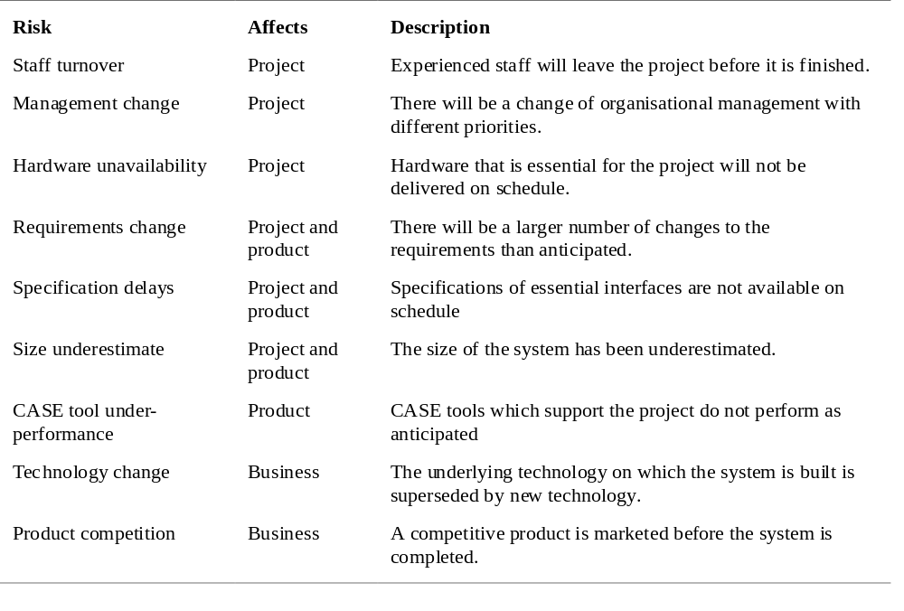
Software risks

Slide 3
The risk management process
Risk identification
  Identify project, product and business risks;
Risk analysis
  Assess the likelihood and consequences of these risks;
Risk planning
  Draw up plans to avoid or minimise the effects of the risk;
Risk monitoring
  Monitor the risks throughout the project;

Slide 4
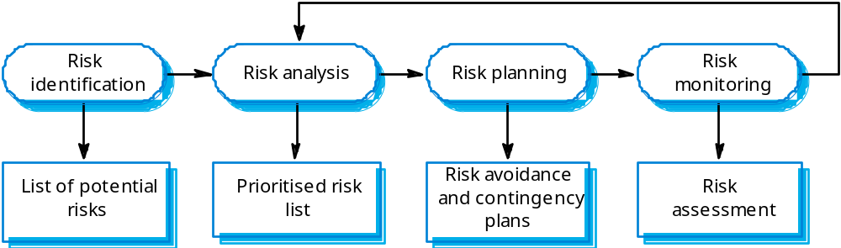
The risk management process

Slide 5
Risk identification
Technology risks.
People risks.
Organisational risks.
Requirements risks.
Estimation risks.

Slide 6
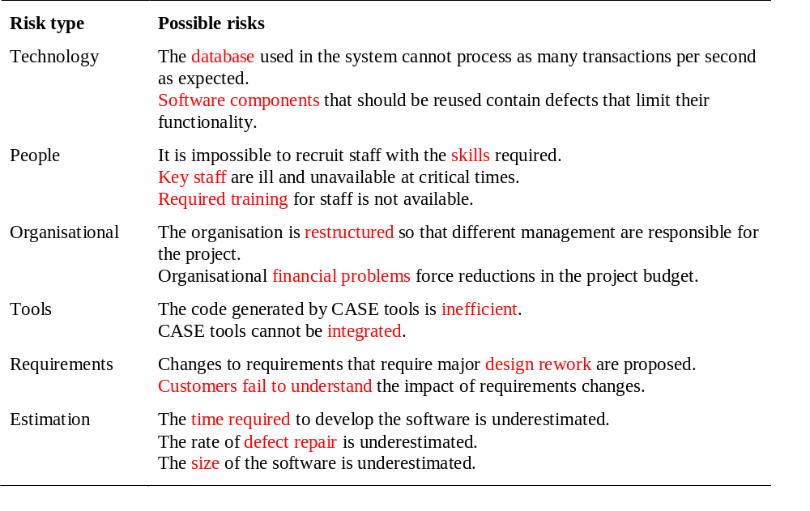
Risk types and risks

Slide 7
Risk analysis
Assess probability and seriousness of each risk.
Probability may be very low, low, moderate, high or very high.
Risk effects might be catastrophic, serious, tolerable or insignificant.

Slide 8
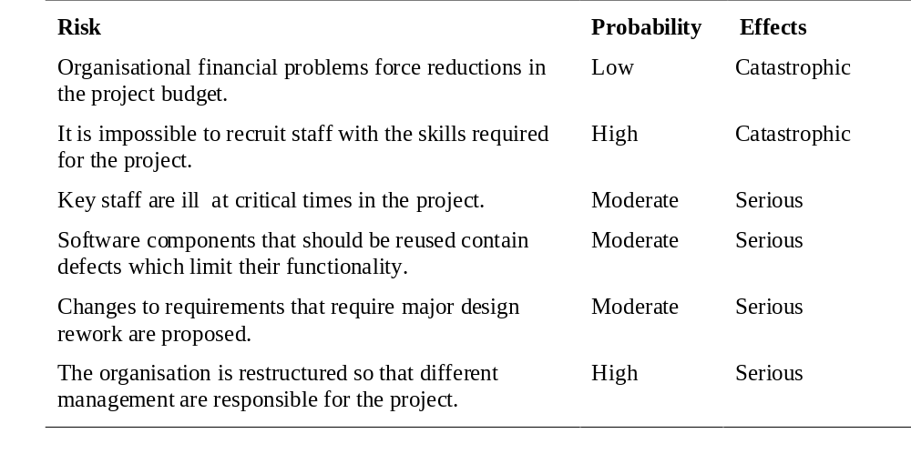
Risk analysis (i)

Slide 9
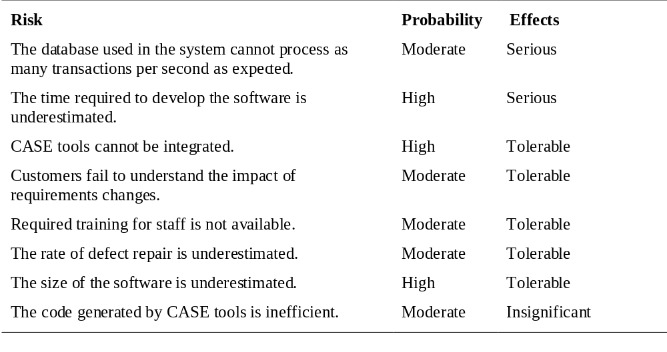
Risk analysis (ii)

Slide 10
Risk planning
Consider each risk and develop a strategy to manage that risk.
Avoidance strategies
  The probability that the risk will arise is reduced;
Minimisation strategies
  The impact of the risk on the project or product will be reduced;
Contingency plans
  If the risk arises, contingency plans are plans to deal with that risk;

Slide 11
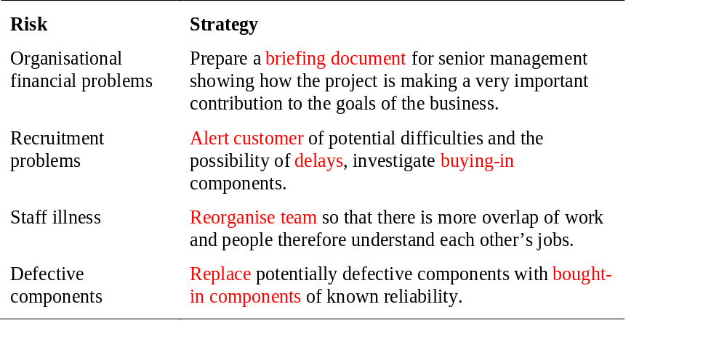
Risk management strategies (i)

Slide 12
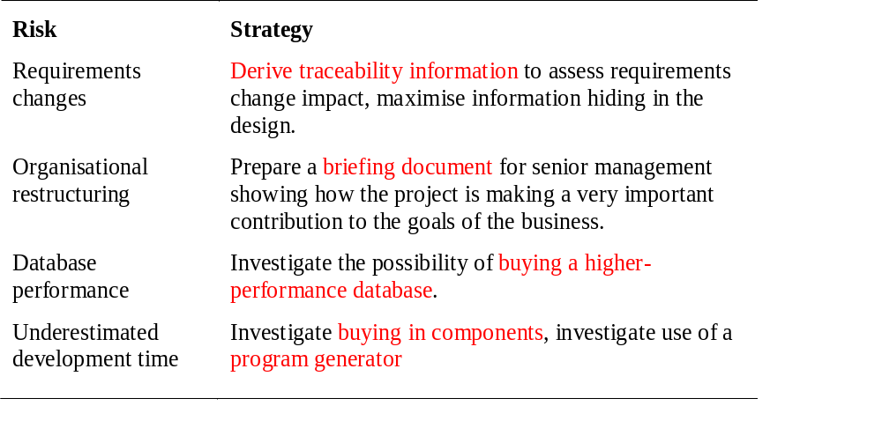
Risk management strategies (ii)

Slide 13
Risk monitoring
Assess each identified risks regularly to decide whether or not it is becoming less or more probable.
Also assess whether the effects of the risk have changed.
Each key risk should be discussed at management progress meetings.

Slide 14
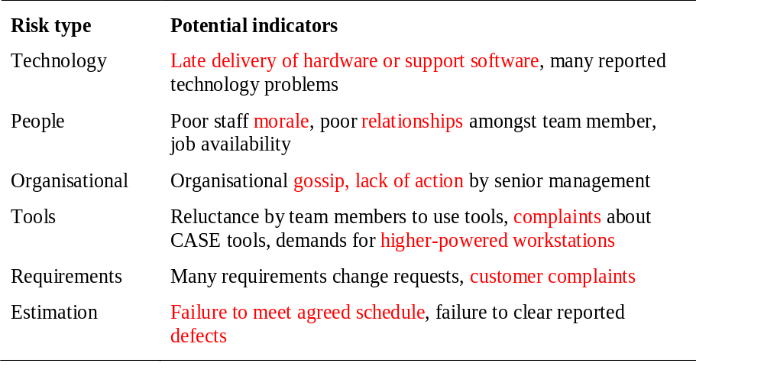
Risk types and indicators

